Slide 1
Generating noisy speech data from clean data in the frequency domain using Deep Learning Methods
Week – 16
Name: Shashank Shirol
University: Manipal Institute of Technology
Duration of the presentation: ~10 mins.

Slide 2
Tasks to be completed:
Modify Normalization code to normalize to a reference signal (instead of quieter of two), try three versions and compare with existing code:
Matchering (a python library for matching one signal to characteristics of a reference signal)
RMS normalization – Takes the RMS loudness value of the ref. signal and normalizes the signal to that loudness.
Pyloudnorm – provides an implementation of ITU-R BS.1770-4 for loudness measurement, the signal is then normalized to that value.
Using the Existing method to compare.
Train the current Implementation with a large dataset including various parallel samples – both long and short, from the RATS corpus.
Under this, we test the effectiveness of using the FFmpeg codec as a pre-processing measure.
We also study the effect of varying the dataset sizes.
Train the current Implementation with a moderately sized dataset with non-parallel samples. This allows us to test the efficacy of the system in a more likely scenario – unavailability of parallel data
We test one non-parallel dataset from the RATS corpus.
We also test the system with ATC speech data from pdgls YouTube channel
Write a module to perform histogram matching allowing us to make the spectrograms of clean and noisy files resemble in colour.

Slide 3
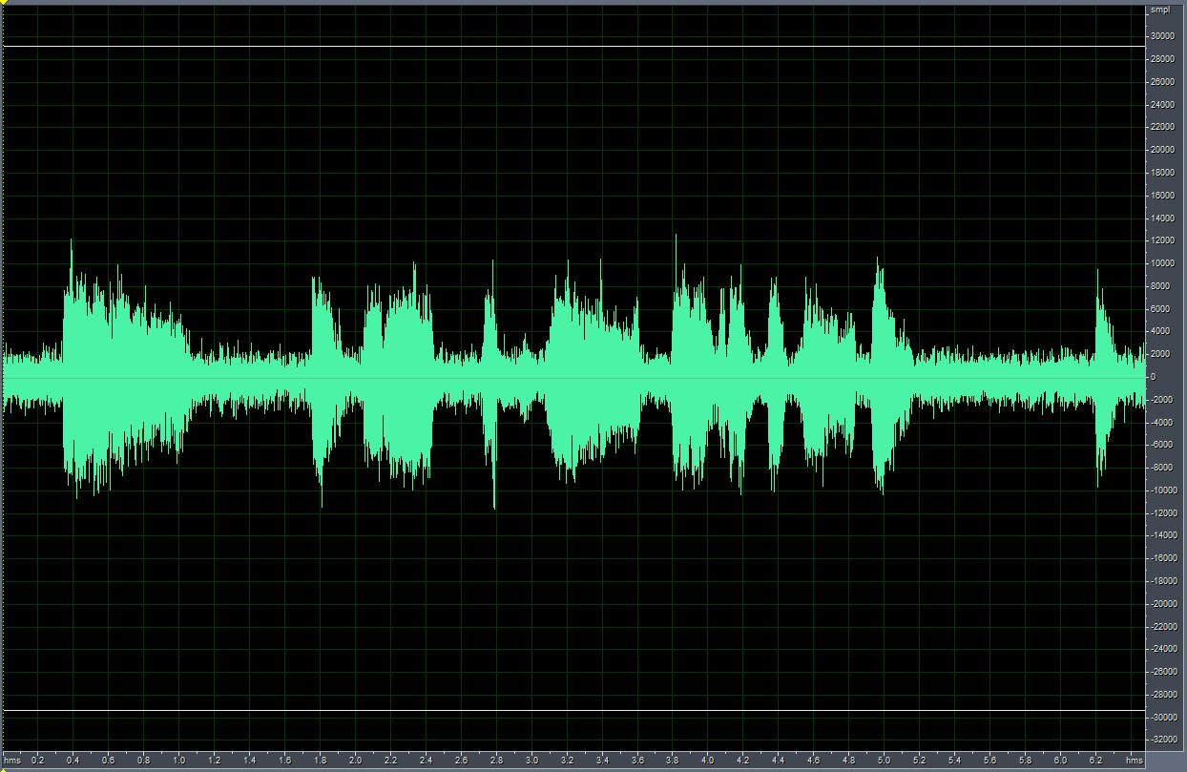
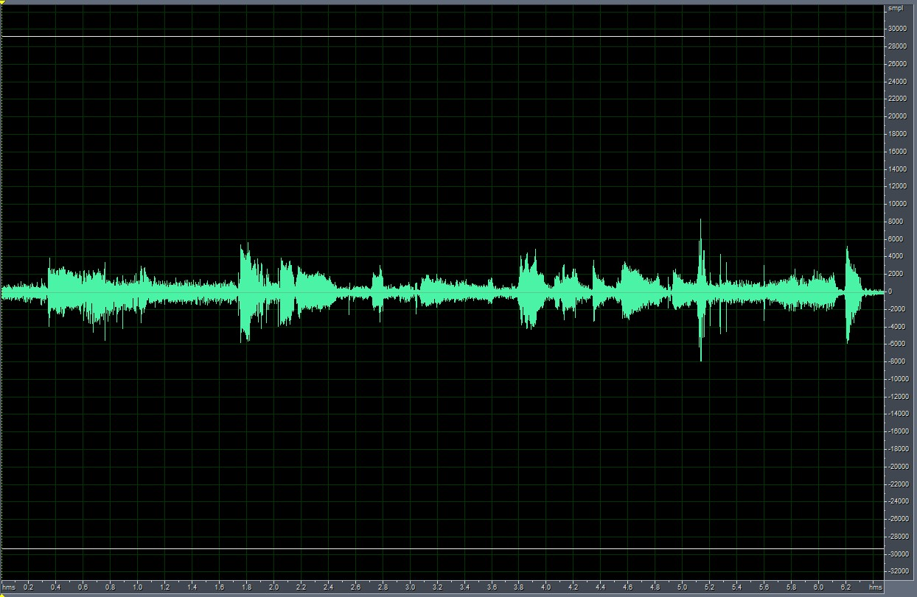

Modifying the Normalization code - (I) Overview:
Matchering – A python library that treats the target file such that it has the same sound characteristics as the reference file.
RMS Normalization – here we use the perceived loudness value to compute the gain value that is used to normalize the target file.
Pyloudnorm – this library measures the loudness of the file according to ITU-R BS.1770-4 algorithm and also provides modules for normalizing a file using the measured loudness.
Using the reference dBFS value to normalize target file to, we make use of pyDub library here.
GT
CUT O/P

Slide 4
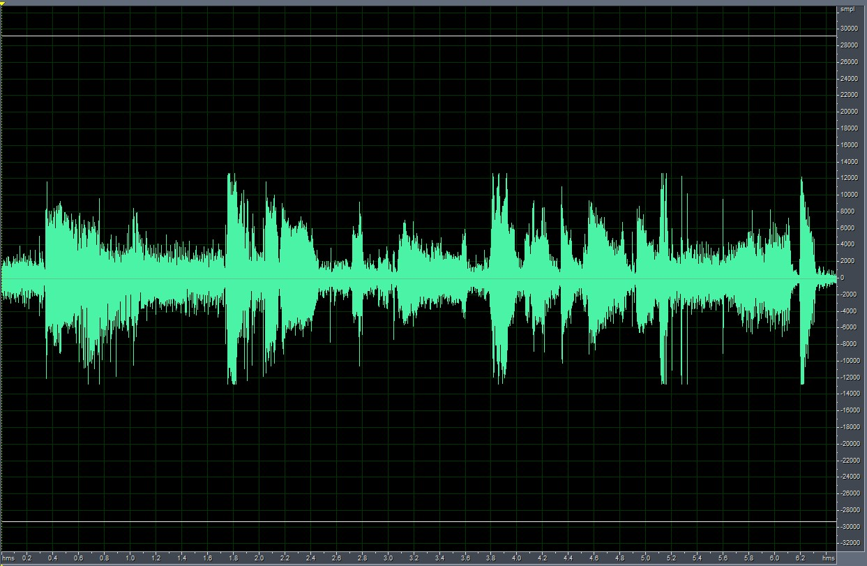
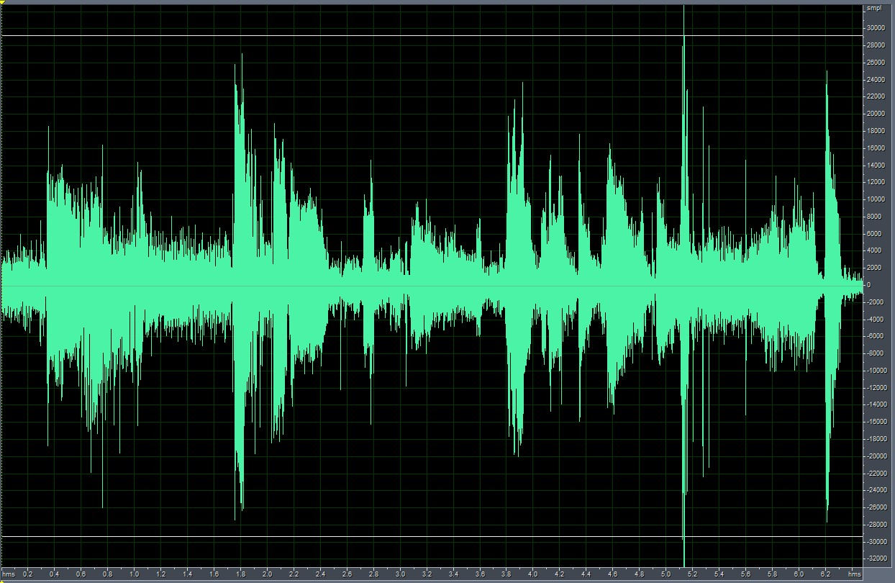
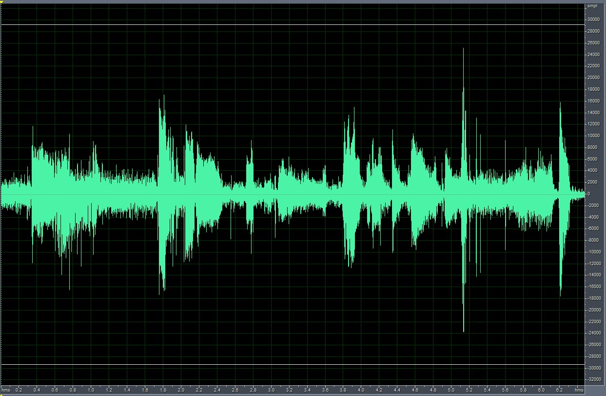
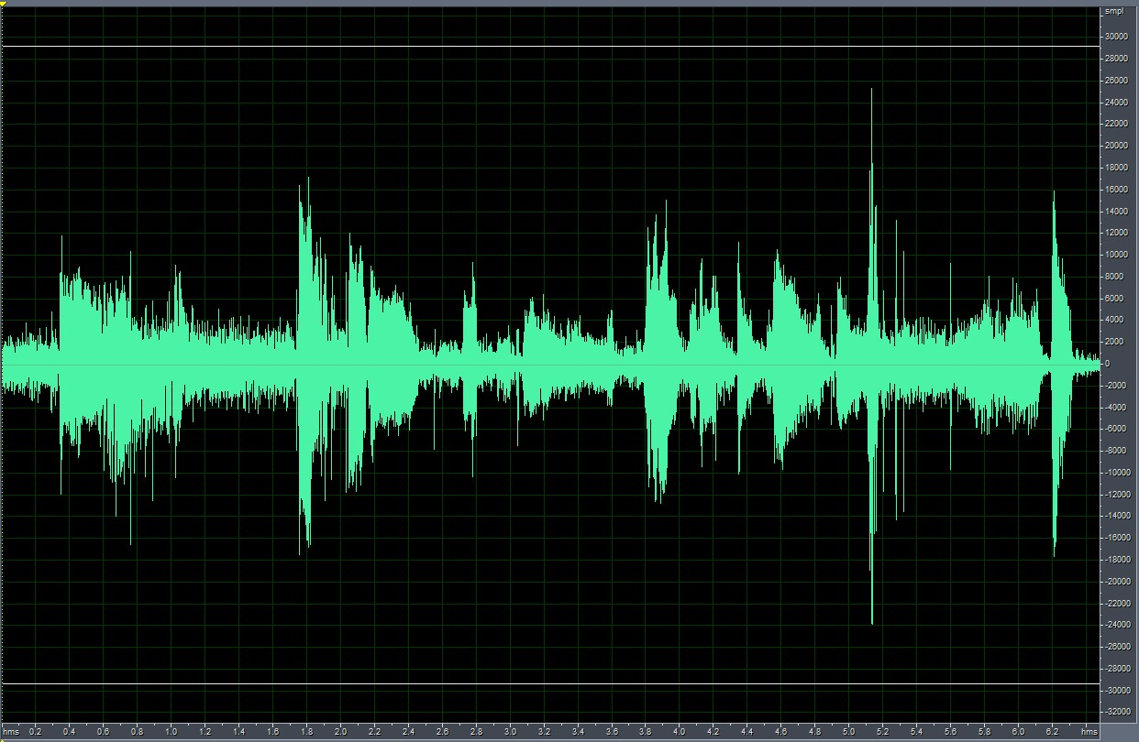
Modifying the Normalization code - (II) Results:
Speed:
0.3s
LSD:
7.6713
Speed:
0.007s
LSD:
7.9701
Matchering
RMS
Speed:
0.01s
LSD:
7.7529
Speed:
0.003s
LSD:
7.7550
Pyloudnorm
Existing

Slide 5
Training CUT with a large dataset: (I)
Here, we train CUT with a larger parallel dataset derived from the RATS corpus.
This dataset contains variable length samples – from shorter (3s) to longer (15s)
Results:
We notice that using FFmpeg with the component-based CUT makes little to no difference to the quality of the output, and in many cases breaks the model.
We verify this through four experimental setups:
Large Dataset (189 components acting as independent samples) plus FFmpeg
Large Dataset (189 components acting as independent samples) minus FFmpeg
Smaller Dataset (43 components acting as independent samples) plus FFmpeg
Smaller Dataset (43 components acting as independent samples) minus FFmpeg
We also realize that performance of the model deteriorates with use of larger dataset – this claim is verified in the subsequent slides.

Slide 6
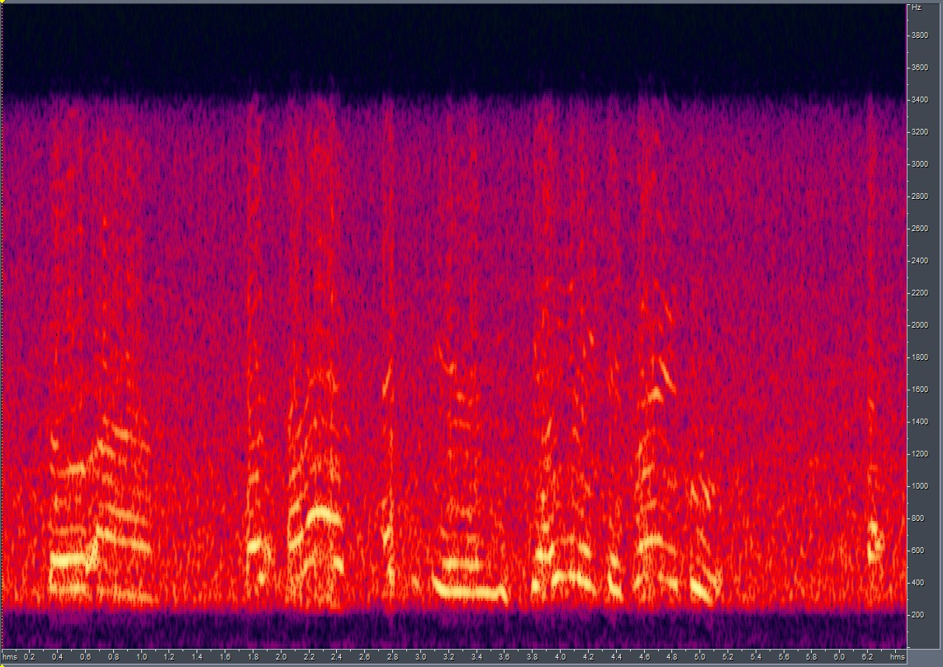
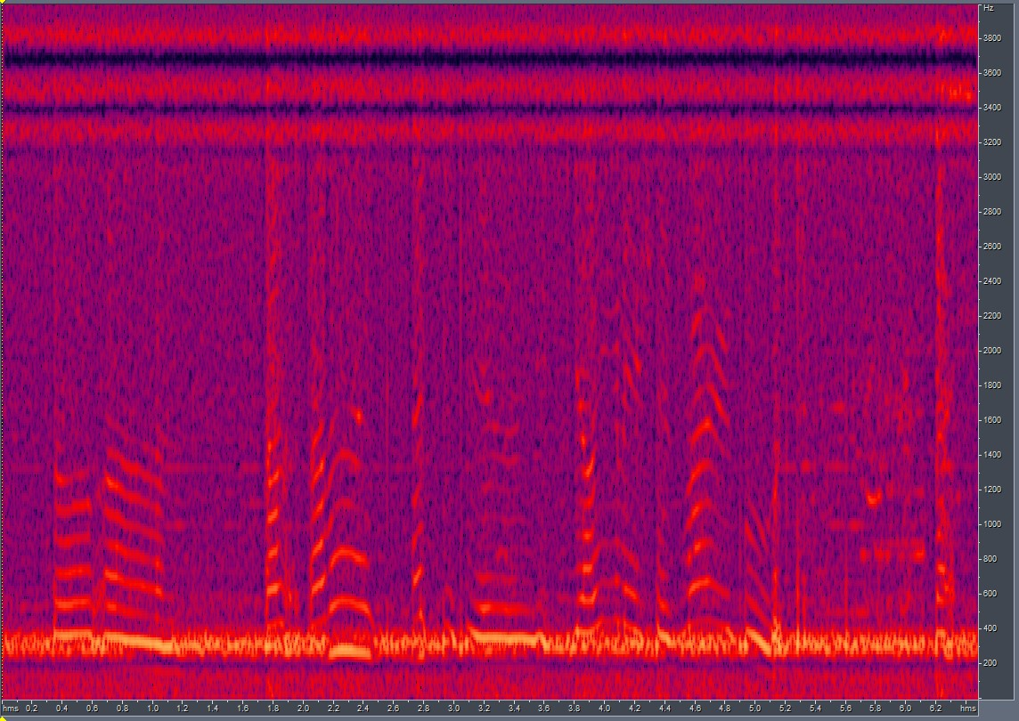
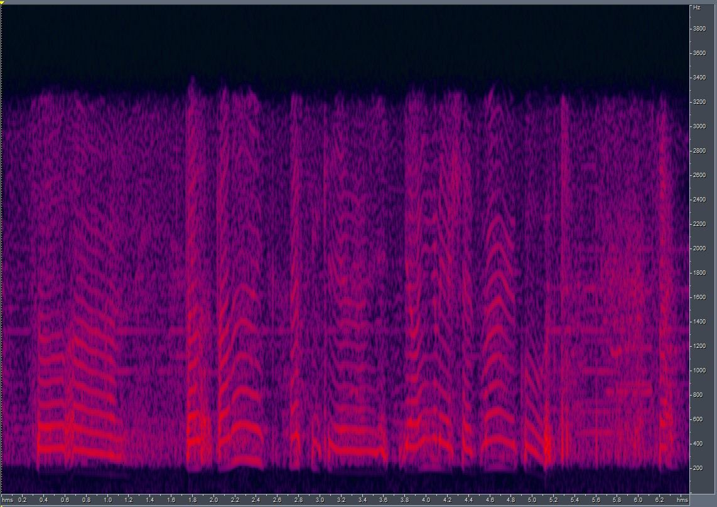
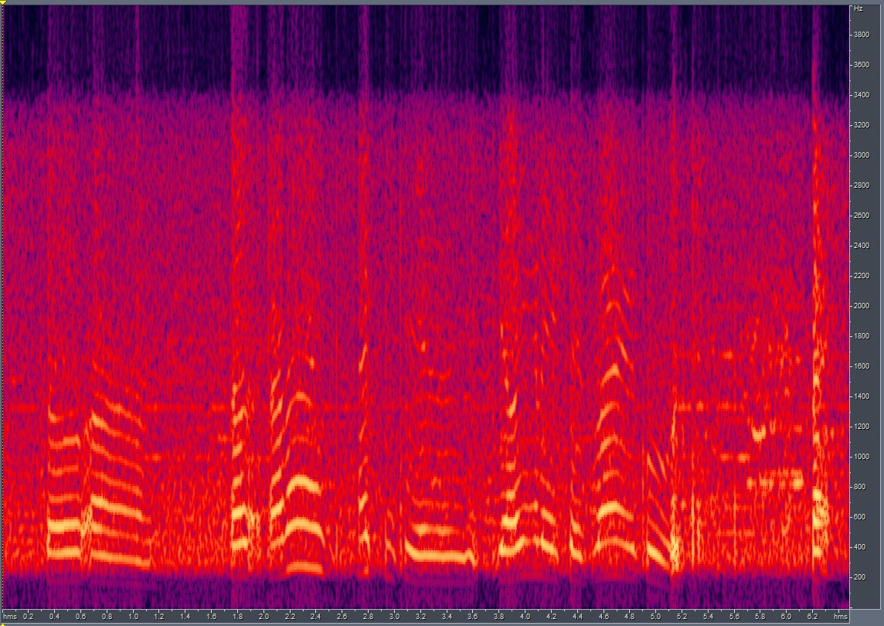
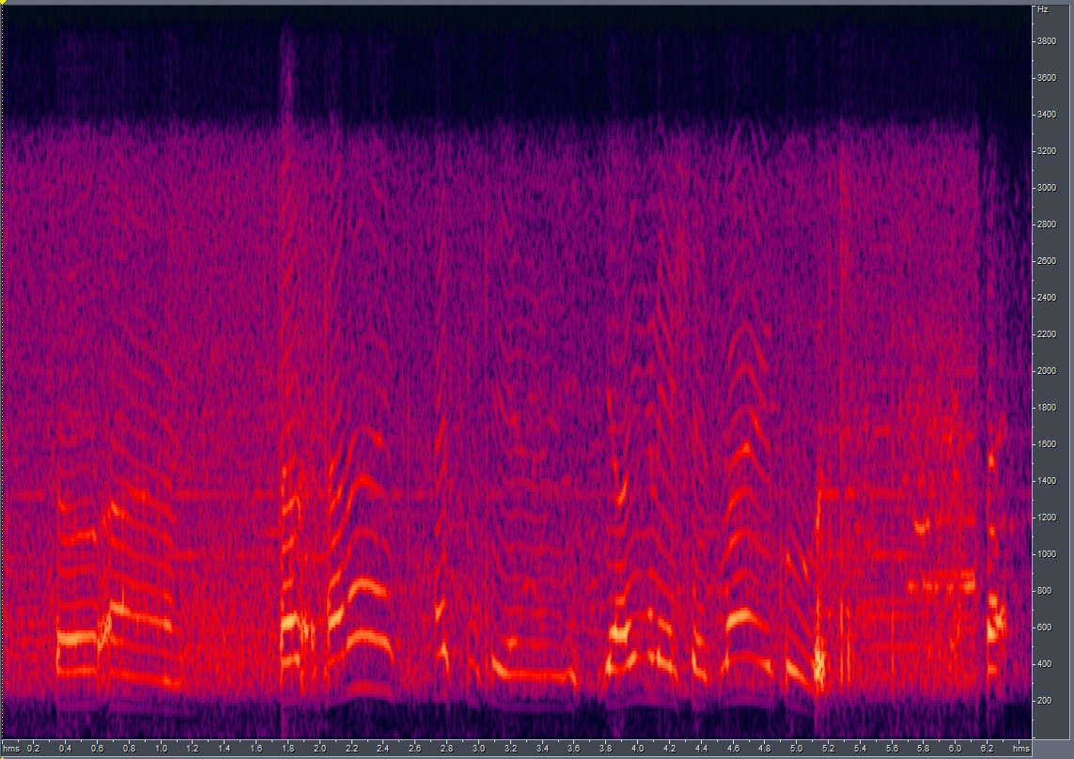
Training CUT with a large dataset: (II)
GT
LSD:
13.9611
LSD:
8.4376
1. Large DS + ffmpeg
2. Large DS - ffmpeg
LSD:
7.9281
LSD:
7.7550
3. Small DS + ffmpeg
4. Small DS - ffmpeg

Slide 7
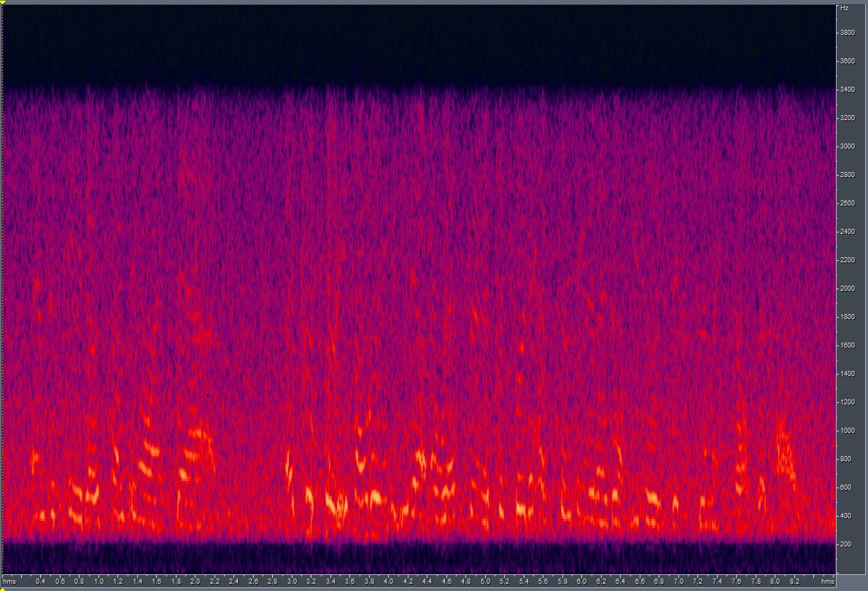
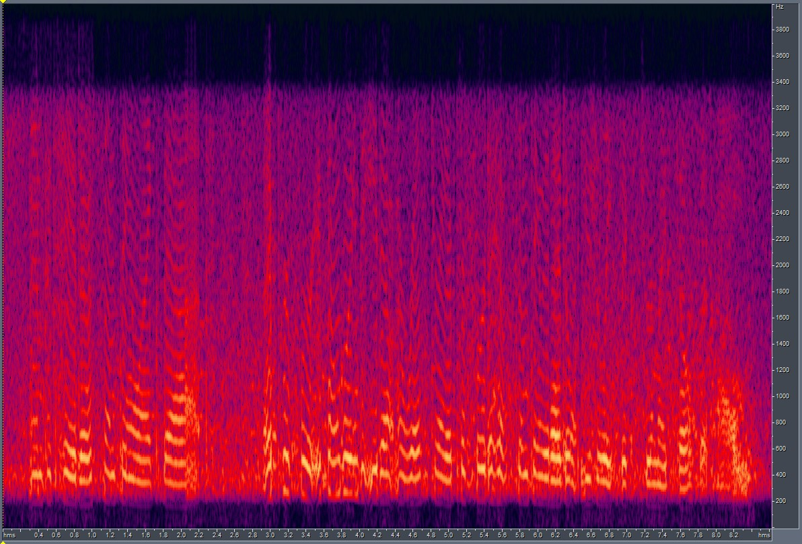
Training CUT with moderately sized unparallel dataset(s): (I)
First, we want to test the impact of using non-parallel data to train CUT.
Based on the findings from previous experiments, we make use of a relatively smaller dataset (90 components acting as independent samples) minus FFmpeg.
We first use a dataset derived from the RATS corpus, the results are as follows:
LSD:
6.2207
GT
CUT output

Slide 8
Training CUT with moderately sized unparallel dataset(s): (II)
Second, we take a different domain for the target – ATC speech
Based on the observation from previous experiment, we try training CUT to learn mapping from clean speech to ATC speech.
For this, we make use of one 30s ATC speech audio taken from pdgls YouTube channel
Pre-processing (for the downloaded ATC speech sample):
Stereo to mono
Resample to 8k Hz.
Remove silent parts.
Normalize to standard -23 LUFS
Downloaded
Processed

Slide 9
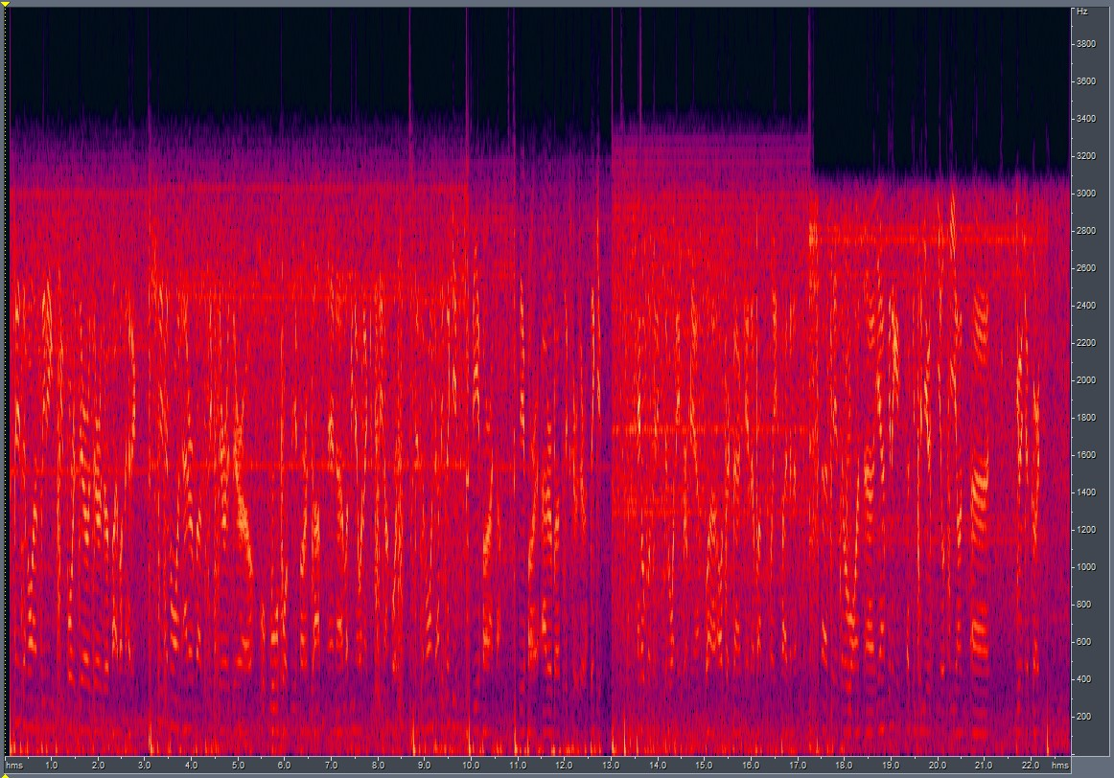
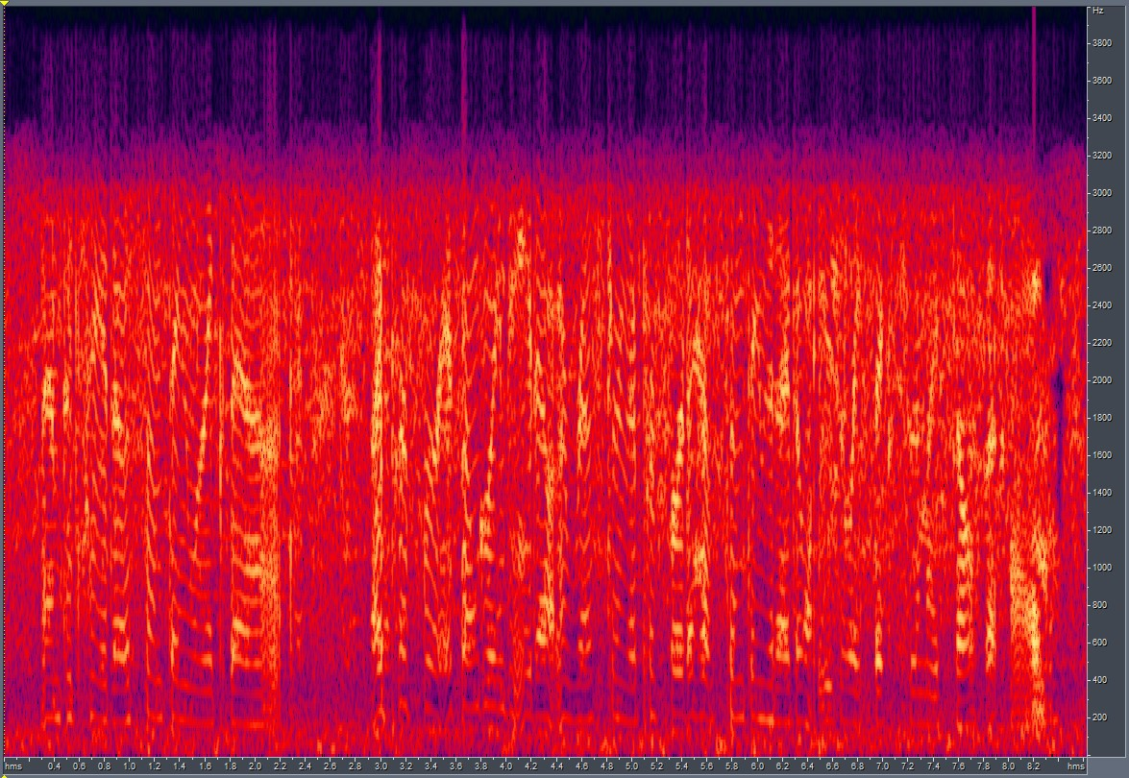
Training CUT with moderately sized unparallel dataset(s): (II)
After training CUT with clean speech audio data from RATS + ATC speech audio file from the YouTube Channel, we get the following results:
File used for training
Output produced by CUT

Slide 10
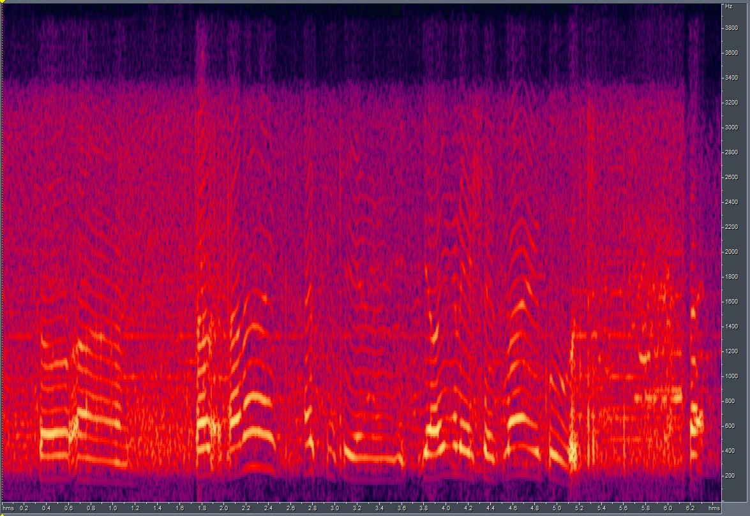
Module for performing Histogram Matching:
Wrote a python script that performs histogram matching for two given images – target and reference.
Results:
GT
Normal OP
Histogram Matched
LSD: 7.7550
LSD: 8.1009

Slide 11
End.

